Slide 1
Macbeth
The Scottish Play
A Tragedy by William Shakespeare

Slide 2
Dramatis Personae
[DUNCAN, King of Scotland.
MALCOLM & DONALBAIN: his sons
MACBETH & BANQUO: generals of the King’s army.
MACDUFF, LENNOX, ROSS, MENTEITH, ANGUS & CAITHNESS: noblemen of Scotland.
FLEANCE, son to Banquo.
SIWARD, earl of Northumberland.
Young SIWARD, his son.
SEYTON, an officer attending on Macbeth.
Boy, son to Macduff.
An English Doctor.
A Scotch Doctor.
A Captain.
A Porter.
An Old Man.
LADY MACBETH.
LADY MACDUFF.
Gentlewoman attending on Lady Macbeth.
HECATE.
Three Witches.
Apparitions.

Slide 3
General Comments
last of Shakespeare’s four great tragedies, written in the late 17th C.
political play written for James I
lesson on how to be a good king and a warning to those who wish to oppose him
Historical facts:
James was a foretold descendant of Banquo
James was a victim of failed assassination attempts
James was one held hostage by the Thane of Glamis
Duncan killed his grandfather to gain the throne, and Macbeth reigned for - 17 yrs. before Malcolm overthrew him. While king, Macbeth united Scotland and established law and order.

Slide 4
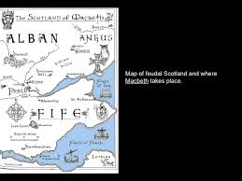

Slide 5
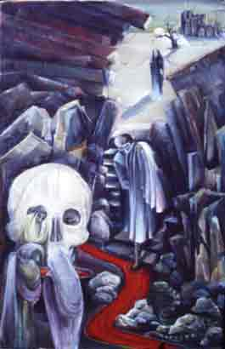
Themes In Macbeth
- Power corrupts, absolute power corrupts absolutely.
- Humans lust for evil and good.
- Committing evil leads to guilt and suffering.
- There are consequences if the natural order of things is disturbed.
- Power is a burden not a comfort.
- Appearance vs. reality.
- Treachery will be punished.
- Violence is sometimes necessary.

Slide 6
Symbols & Motifs in Macbeth
Symbols
Blood
The Weather
Motif
Hallucinations
Violence
Prophecy

Slide 7
Macbeth is a play about a man at war with his own soul. The question is how does Shakespeare view men/humans?
Life’s but a walking shadow, a poor player
That struts and frets his hour upon the stage
And then is heard no more: it is a tale
Told by an idiot, full of sound and fury,
Signifying nothing. (5.5.26-30)

Slide 8
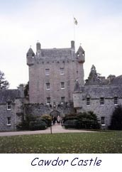
The Setting
- Macbeth ruled Scotland from 1040 a.d. to 1057 a.d.
- Scene One of Act One introduces the influence of the supernatural.
- In Medieval times, people thought that witches’ familiars were devils in disguise.
- The witches are called the “weird sisters” from the Old English word “wyrd” meaning fate.
- 1542-1688, a thousand witches were executed in England and Scotland.

Slide 9
The Three Witches
The first witch’s familiar is named Graymalkin, and comes in the form of a cat.
The second witch’s familiar is Paddock, a toad.
The third witch’s familiar is Harpier, an owl.
Legend has it that the source of witchcraft is Lilith. This woman was said to be the first biblical wife of Adam. She was sent from the Garden of Eden because she would not submit to her husband because she believed they were equal. She became an owl. This becomes very significant in the play.

Slide 10
The Tragic Hero
1. a leader in his society, exemplifying both the good and bad elements of that society ('a person neither wholly good nor bad').
2. disclosed to the audience at the height of his prosperity, power, and influence in that social group so that his fall from its favour will seem that much greater (and, therefore, more tragic).
3. driven to his fall (social alienation, suffering, death, or exile) by some innate flaw (Greek: hamartia) in his nature, yet appear to have the ability to alter his course. (In other words, he should appear to possess free will, and yet be a victim.)
4. made a scapegoat for the sins or errors of his people--and accordingly be exiled or punished by them in such a way that his suffering is irreversible (since Oedipus is blinded, his suffering cannot be reversed).

Slide 11
The Tragic hero
5. the cause of his own punishment through his own pride (hubris).
6. ready to take upon himself the burden of his society's (and hence the audience's) sense of guilt, shame, or short-coming.
7. grander and more noble as the result of his futile struggle with fate.
8. through his suffering instrumental in the resolution of a problem that plagued his society at the outset, and in the restoration of a harmony that was not present at the opening of the play. Our grieving over the destruction of the hero but our relief over the restoration of social harmony produces in the audience what Aristotle termed "catharsis" or "tragic satisfaction" through the purgation of pity and fear.

Slide 12
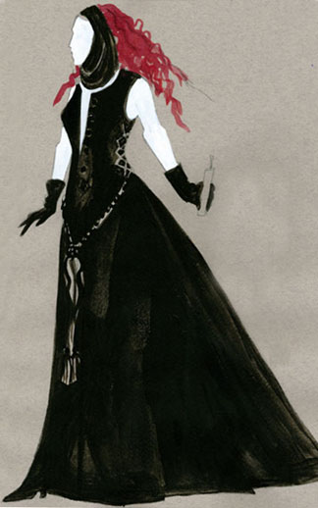
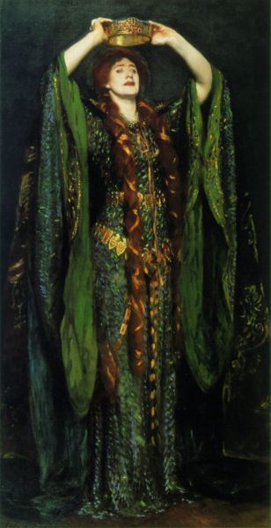
Lady Macbeth

Slide 13
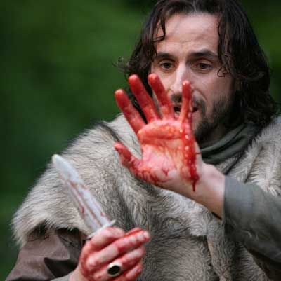
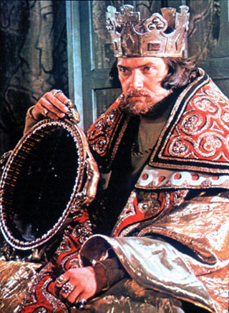
Macbeth

Slide 14
Fate, Destiny and the Supernatural
Do you believe in a predetermined destiny? Why or why not?
Did someone ever predict something that seemed improbable that actually happened?
Did this prediction change your actions so that the event was more likely to occur or did the event simply seem to occur with your assistance?
Discuss your feelings upon hearing the prediction.

Slide 15
Other Opening Questions
What characteristics are common to ambitious people?
Are there any positive characteristics?
Does our society have a negative view of ambitious people?
Does our view change according to gender?
Should citizens rebel against a tyrant?
What do you believe is a good marriage?
Power corrupts. Thoughts?
We should be suspicious of all those who desire to rule.

